Slide 1

Micro Services Architecture Alex Lundin October 16 2017
[1]

Slide 2
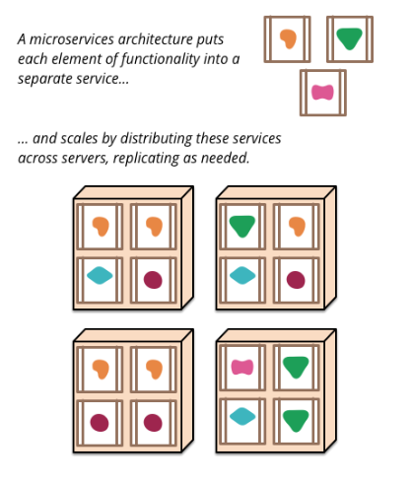
Intro
Micro Services:
Developers
Companies
Definition
[2]

Slide 3

Need
Bank of America’s Customers
Wide range of mobile devices
[3]

Slide 4
Satisfaction
Monolithic
Micro services
Hybrid

Slide 5
Visualize the solution
Stay Monolithic
Not viable
All in Micro services
Growing pains
Hybrid
Legacy support
Plan for future

Slide 6
Action
Bank of America
Create developer team
Plan future projects
Rebuild previous architecture

Slide 7
Wrap Up
Micro Services Definition
Hybrid Solution for Bank of America
Timing and implementation are key

Slide 8
Final Note
Micro Services is all about:
When
How

Slide 9
References
[1] [online], Available at: https://www.famouslogos.us/images/bank-of-america-logo.jpg
[2] Why Companies Adopt Microservices And How They Succeed , [online], Available at: https://medium.com/microhq/why-companies-adopt-microservices-and-how-they-succeed-2ad32f39c65a [Accessed 16 Oct. 2017].
[3] [online], Available at: http://blog.nskinc.com/hubfs/Mobile_Technology.jpg?t=1507149057471

Slide 10
Contact Information
Alex Lundin
Software Engineering
Junior
AML140830@utdallas.edu

